Slide 1
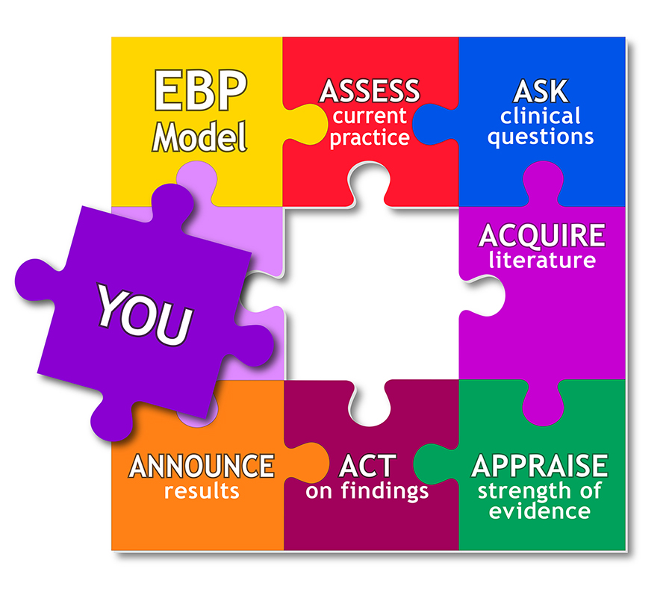
Evidence Based Approaches
Week 3
Evidence based Approaches

Slide 2

Aim;
Explain the role of research for evidence-based practice in health and social care
Learning outcomes At the end of this lesson students will be able to ;
1-Explain the purpose of evidence-based practice
2-Describe the ability of EBP to gain access to new ideas and thinking in finding solutions to health care problems.

Slide 3
LO1 Activity-10 minutes
What is evidence based practice in healthcare?
Feedback to the class

Slide 4
WHAT IS EVIDENCE-BASED PRACTICE?
EBP is the use of clinical research to determine the best forms of patient care. By studying research, expert opinions, and other forms of data, nurses can identify ways to provide optimal patient care.
The EBP systematic process includes the following steps:
Ask a question.
Search the latest research.
Incorporate clinical experience.
Accommodate patient preferences.
Apply the results.

Slide 5
Evidence-based practice
Evidence-based practice looks at research findings, quality improvement data and other forms of evaluation data, and expert opinion to identify methods of improvement.
It's identifying what exactly differentiates evidence-based practice from research that can be challenging for staff members.
"Evidence-based practice is used to close the gap between the research being conducted and the practice.

Slide 6

To provide effective care
You have a professional responsibility to practice evidence based care in order to empower your individual profession through the use of knowledge but there also exists a moral necessity as healthcare practitioners are accountable to society for the care that they deliver.
Sick people are vulnerable and trust those with expert knowledge to advocate on their behalf through the delivery of the best care possible;
You can only deliver the best if you know what the best is.
In order to determine the best you have to investigate.
Healthcare providers have a duty to safeguard all patients from
harm and minimize risk.

Slide 7

Elements...
Use the best available current evidence
Consider the preference of the individual/client
Practitioner to use their own expertise and experience to make decisions
Notes:
Evidence-based practice is an amalgam of scientific and professional practice…..
‘Evidence-based’ implies concepts of scientific rationality and ‘practice’ is about individual practitioners behaviour….in essence it is theory practice integration
So all three elements should be used together – over riding principle is to give the most effective care to maximise the quality of life of the individual.

Slide 8

5 steps
Identify
1
Identify a problem from practice and turn into a specific question
Find
2
Find the best available evidence
Appraise
3
Appraise the evidence for its validity – usefulness and methodological rigour
Identify
4
Identify current best evidence and apply to the situation
Evaluate
5
Evaluate the effect on the client & practitioners own performance
Notes:
This might be about the most effective intervention for a particular client or an assessment of causation, or about the most appropriate test, or method for delivering a service,
so look for best available evidence that relates to the question – usually by making a thorough search of the literature.
4. So think about the clients preferences when the evidence is applied to the situation.

Slide 9

Types of evidence
Evidence evidence everywhere!!!!
Research
Professional opinion
Randomised controlled trails
Teaching from formal education
Clinical guidelines
Benchmark statements

Slide 10
Evidence-based practice holds Great promise
Choose a question
Search for the best evidence
Is it reliable, valid and applicable?
Integrate evidence with own expertise
Evaluate the outcomes of EBP decision
Share outcome
Evidence-based practice holds great promise for moving care to a high level of likelihood for… producing the intended health outcome.
The definition of healthcare quality is foundational to evidence-based practice.
Development of evidence-based practice is fueled by the increasing public and professional demand for accountability in safety and quality improvement in health care.

Slide 11
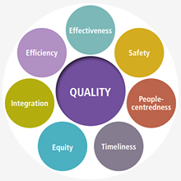
Definition of Quality Healthcare
Degree to which health services for individuals and populations increase the likelihood of desired health outcomes and are consistent with current professional knowledge.

Slide 12

Definition of Quality Healthcare-contd..
The phrases in this definition bring into focus three aspects of quality: services (interventions), targeted health outcomes, and consistency with current knowledge (research evidence).
It expresses an underlying belief that research produces the most reliable knowledge about the likelihood that a given strategy will change a patient's current health status into desired outcomes.
Alignment of services with current professional knowledge (evidence) is a key goal in quality. The definition also calls into play the aim of
reducing illogical variation in care by standardizing all care to
scientific best evidence.

Slide 13
Evidence based practice for service improvement
Research and Evidence-Based Practice emphasizes how to identify clinical questions, critically assess evidence and convert findings into healthcare practice.
Health and social care practitioners learn to seek the most current scientific evidence in order to provide excellent patient care.
Evidence-based practice in healthcare is crucial to successful patient care, and it is also a good tool for shaping policies, procedures and safety regulations.
Thus, EBP continues to improve our healthcare systems both for patients and healthcare professionals.

Slide 14


10 minutes break

Slide 15

How Is EBP Incorporated In Healthcare?
EBP helps healthcare practitioners determine an effective course of action for care delivery.
EBP involves the following five steps:
Form a clinical question to identify a problem.
Gather the best evidence.
Analyze the evidence.
Apply the evidence to clinical practice.
Assess the result.

Slide 16
What Kind Of Research Is Used In EBP?
Research utilized in EBP falls into four categories. They are:
Randomized controlled trials.
Evidence gathered from cohort, case-control analysis or observational studies.
Opinions from clinical experts that are supported by experiences, studies or reports from committees.
Personal experience.
The above four categories are listed in descending order from most credible to less reliable.

Slide 17

Now…let’s look at the history Of EBP
Florence Nightingale was credited with improving patient care in the 1800s when she noted that unsanitary conditions and restricted ventilation could adversely affect the health of patients.
She went on to record medical statistics using patient demographics to ascertain the number of deaths in hospitals and the mortality rate connected to different illnesses and injuries.
Archie Cochrane introduced the concept of applying randomized controlled trials (RTC) and other types of research to the nursing practice in 1972.
Before Cochrane's contribution to healthcare, medical care centered on unfounded assumptions without consideration for the individual patient.

Slide 18
History Of EBP-contd..
Cochrane proposed that healthcare systems have limited resources so they should only use treatments that are proven to be effective.
He believed that RTCs were the most verified form of evidence and his assertion created the foundation for the EBP movement.
In 1996 David Sackett introduced the term evidence-based medicine along with a definition that is still widely used today.
Unlike Cochrane, Sackett felt that EBP should not only focus on research but should merge evidence, clinical experience and patient values.

Slide 19
History Of EBP--contd
As other healthcare professions began adopting Sackett's concept for patient care, it was renamed evidenced-based practice.
EBP is an essential component of safe, quality patient care. healthcare practitioners must be aware of current practices in order to provide care to patients with complicated and debilitating conditions.
Healthcare and Nursing students learn the role of research in the nursing practice.
These programs cover the design, methodologies, process and ethical principles of research.
In addition, nursing students use critical thinking skills to evaluate and critique research studies in order to apply the findings to their nursing practice.

Slide 20
LO2 Activity-10 Minutes
Individually, research the Advantage Of EBP For patients, practitioners and healthcare Organizations?
Feedback to the class
Patients/ service users | Healthcare Practitioners | Healthcare Organisation

Slide 21
How Does EBP Benefit healthcare practitioners and patients?
The inclusion of EBP in healthcare practitioners provides nurses with;
The scientific research to make well-founded decisions.
Through EBP, healthcare practitioners can stay updated about new medical protocols for patient care. By searching for documented interventions that fit the profiles of their patients, nurses can increase their patients' chances for recovery.
EBP enables healthcare practitioners to evaluate research so they understand the risks or effectiveness of a diagnostic test or treatments.
The application of EBP enables healthcare practitioners to include patients / service users in their care plan.
This allows patients to have a proactive role in their own healthcare since they can voice concerns, share their values and preferences and make suggestions on how they want to proceed.

Slide 22
Advantages EBP
(Ross, 2012)
Patients/ service users | Practitioners | Organisation
Reduces the amount of time wasted on inappropriate care options Increased consistency as all patients receive the same level of care Increased confidence in practitioners as their knowledge of options is transparent Increased value for money Reduced variation of services Evidence can be used to support the need for additional resources | Professional empowerment through enhanced knowledge Increased personal and professional confidence in problem solving as practitioners adopt a critical approach Increased quality of care through patient satisfaction and positive healthcare outcomes Protection against litigation through rationales for action Ability to scientifically support actions | Enhance quality of service delivery as practitioners can draw upon a variety of options Enhanced confidence in the workforce as decision making is reflected in enhanced care outcomes Reduction in complaints and litigation Observable commitment to clinical governance Increased cost effectiveness and value for money Evidence for the allocation of resources

Slide 23
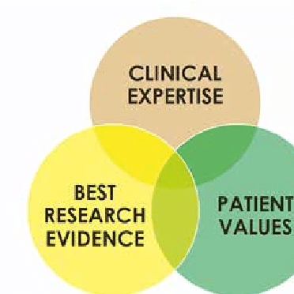
The Advantage Of EBP For Healthcare Organizations?
With the application of EBP comes better patient outcomes, which can decrease the demand for healthcare resources.
Thus, healthcare organizations can reduce expenses.
For example, outdated practices may have included supplies, equipment or products that are no longer necessary for certain procedures or techniques.

Slide 24
Evidence-based healthcare decisions
Many healthcare systems have adopted EBP to create policies that address administrative and safety issues as well as patient satisfaction.
It is important for organizations to use EBP when determining dress code policies or how to help nursing staff cope with alarm fatigue.
The PICOT model is a technique healthcare professionals can use to frame a clinical question and find an answer:
P — Patient or problem. I — Intervention or issue. C — Comparison. O — Outcome. T — Time

Slide 25

Practical examples of EBP
When nurses look critically at existing methods, they can improve medical care. For instance, the treatment for acute muscle strain has changed over the years.
Previously, nurses learned to ice certain injuries for the first 24 hours and then apply heat to increase blood flow. Now, evidence shows that only heat is beneficial.
Evidence-based practice challenges nurses to look at the "why" behind existing methods and processes in the search for improvement.

Slide 26

The Nursing council was charged with evaluating various sources of evidence related to a nursing staff dress code and patient perception.
Based on the evidence review, recommendations would be made as to whether the current dress code needed to be changed.
EBP replaces policies and procedures based on other sources of evidence such as tradition or authority.
It takes into account three things healthcare students should consider at all times: best practice evidence, patient preferences and clinical expertise.

Slide 27
EXAMPLE:
The benefits of a dress code
An important concern for many healthcare facilities is whether or not patients can identify nurses. Dress codes can also affect the spread of infection by restricting exposure to unsterile garments. Personal accessories can also affect patient perceptions — nurses need to appear professional.
Evidence-based dress code
Healthcare organizations can turn to EBP to determine the appropriate dress code for their facilities. If the organization cannot find research to guide them, they can form a committee to conduct their own. Here are some questions the committee may pose:
What attire do patients perceive as professional?
How do patients recognize a nurse?
What do patients think nurses should wear?
Once it has developed a survey, the committee can distribute it to patients. Asking staff about their attire preferences and consulting with other healthcare systems can also yield useful data. Afterwards, the committee can evaluate the results to develop a dress code that is right for their facility.

Slide 28

Nursing dress code implemented
The mother/infant unit had previously implemented a dress code based on the recommendations wear solid lilac or a combination of lilac and white, while care partners wear solid purple.
Gold and black identification tags with the employee’s professional title were issued to staff. This tag, which lies behind the staff’s picture ID, helps patients, family members, and other healthcare team members to distinguish who is providing care to the patient.

Slide 29
NURSES AND ALARM FATIGUE
Nurses hear many alarms in the course of their work, which can lead to desensitization to sound.
Many healthcare devices feature audible alarms, such as beds, infusion pumps, cardiac monitors, ventilators and mechanical vital sign machines.
While these alarms are essential, research shows that 72 to 99 percent of alarms that go off do not indicate an emergency.
Unfortunately, patient deaths have occurred due to alarm fatigue; a famous case occurred in a Boston hospital.
The patient’s alarm volume was turned off — possibly to stop the annoyance of an unneeded alarm — so nurses did not have any indication that the patient was in distress.

Slide 30
EVIDENCE-BASED ACTION AGAINST ALARM FATIGUE
Healthcare facilities need to commit to eliminating alarm fatigue. They can assemble a team to collect data on the cases of false alarms and response times.
The following questions can guide their research:
What types of alarms do nurses rely on and in which areas?
What are the various levels of alarms (high, medium or low)?
What is the frequency of alarms?
What is the alarm response process?
What are the impediments to alarm response?
After gathering this information, nursing staff can create protocols to ensure suitable patient monitoring. Nurses should understand the various alarms in use throughout their healthcare facilities, so they can devise backup plans to guarantee alarm response.

Slide 31
Four components of clinical inquiry
Clinical inquiry consists of four components to improve health for patients, families, and communities.
Research begins with a question and uses systematic, scientific inquiry to answer it. Research generates new knowledge and is integral to professional practice.
Evidence-based practice uses the best scientific evidence, integrated with clinical experience and patient values and preferences, to ensure the best possible patient care.
Process and quality improvement allows nurses to improve systems at the local level using Plan, Do, Check, Act to monitor performance and improve outcomes.
Innovation involves applying creativity or problem-solving skills to adopt a new product or service to meet a need.

Slide 32
ASSESSMENT SUBMISSION
All assignment will be submitted in electronic format and uploaded to LSC Portal on Turnitin
Date assignment set: March 2021
Submission deadline date: 1st June 2021
Return date to students: 28/06/2021
Word Limit: 2500 words
Assessment Weighting Criteria (100%)

Slide 33
Reference
https://learnonline.eiu.edu/articles/rnbsn/evidence-based-practice-important.aspx
DOI: 10.3912/OJIN.Vol18No02Man04
(IOM 1990; 2013, para 3).
Sackett et al 2000

